Slide 1
SMART RFID KAMSIS SYSTEM AT PTSS
MOBILE APPLICATION IN ANDROID STUDIO

Slide 2
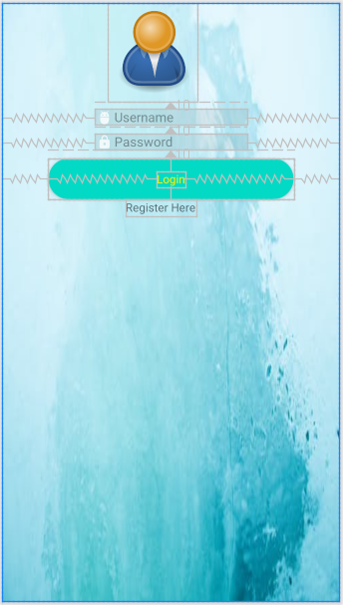
LOGIN INTERFACE

Slide 3
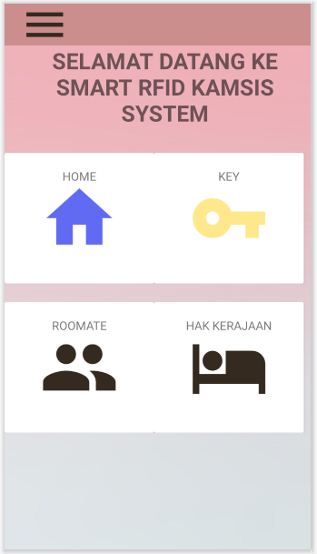
DASHBOARD INTERFACE

Slide 4
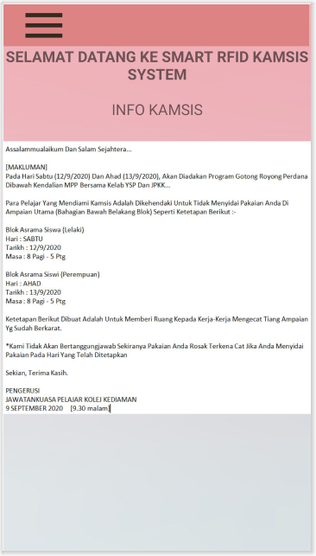
Home interface

Slide 5
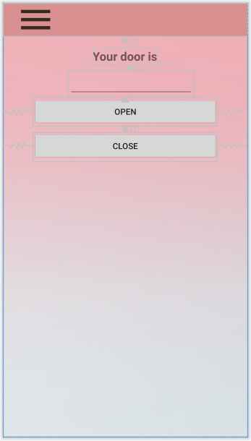
Key interface

Slide 6
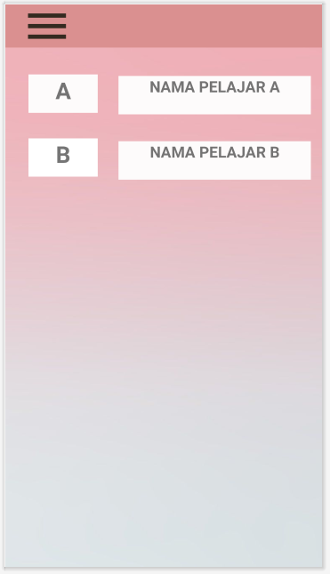
ROOMMATE interface

Slide 7
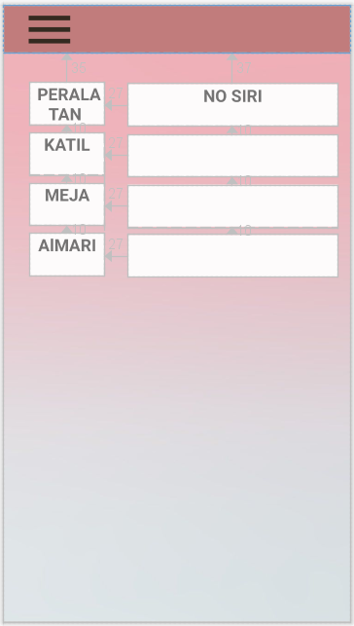
Hak kerajaan interface

